Slide 1
Who are the prisoners?
António Pedro Dores, June 2017

Slide 2
Discrimination
Gender prison discrimination is it deeper than race, nationality or even age discrimination?
What is gender? Is not it the reverse of social differentiation?
Are there two genders or one elite gender and all the rest alike?

Slide 3
Index
Prisoners are not the poor
Moral and violence
Social theory and violence
Sociological pragmatics in time of transformations

Slide 4
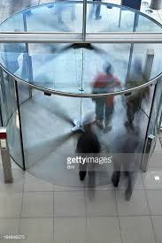
Prison revolving doors

Slide 5
Sex of prisoners
Source: https://www.bop.gov/about/statistics/statistics_inmate_gender.jsp
Source: http://www.prisonstudies.org/highest-to-lowest/female-prisoners?field_region_taxonomy_tid=All

Slide 6
Prisoners compare poor people
Source: https://www.wilsoncenter.org/sites/default/files/Poverty_Statistics_Mexico_2013.pdf and
http://www.insightcrime.org/news-analysis/study-highlights-overcrowding-and-violence-in-mexicos-prisons
Source: https://talkpoverty.org/poverty/
Source: https://www.rtp.pt/noticias/mundo/privacao-material-severa-em-portugal-acima-da-media-da-ue-apesar-de-recuo-eurostat_n911363 and
http://www.dn.pt/portugal/interior/populacao-em-risco-de-pobreza-mantemse-em-2014-mas-situacao-piorou-para-as-mulheres-4823454.html

Slide 7
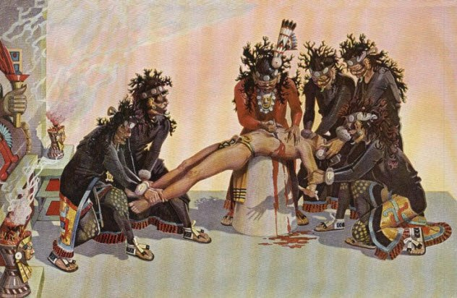
Who can assure that modern societies do not use human sacrifices, any more ?
Photo credit: amantidellastoria.com

Slide 8
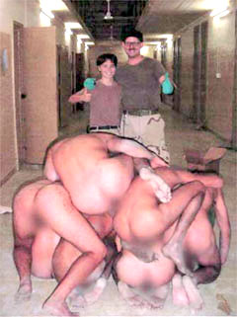
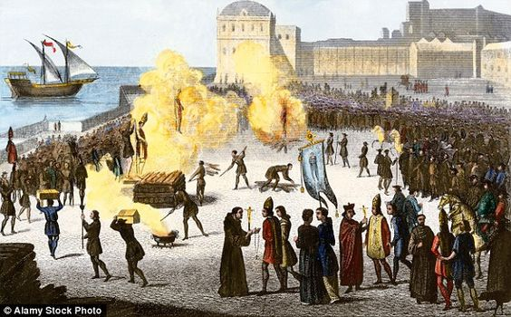
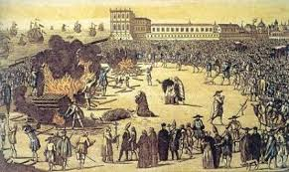
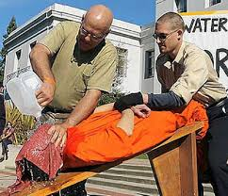
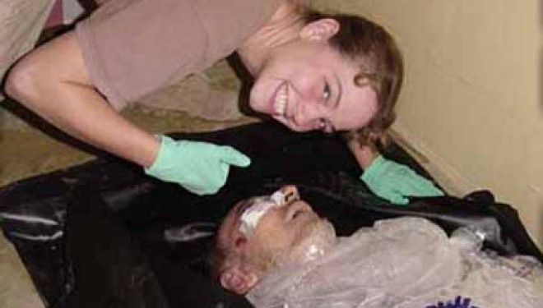

Slide 9
Interpretation depends on point of view
Top down
Up state – statistics as if it was the state that produces society subsystems
Notes:
A teoria social actual descreve estatisticamente os diferentes mundos (do trabalho, do crime, do ensino, etc.) como se fossem comunidades autónomas dos cuidados de que todos precisamos para nos mantermos vivos. Os presos são, neste sentido, rapazes pobres e mal-educados. Mas a teoria social pode adoptar uma outra forma de entender a sociedade, mais científica. Pode reconhecer como a sociedade humana é um resultado da evolução e cada humana é, ao mesmo tempo, um exercício e um actor dessa evolução. Nesta outra perspectiva, os estados de espírito ora se salvam (socializam) ora sucumbem (como os simbólica e praticamente sacrificados) como descobriu Primo Levi (2008) ao compreender que não bastara ter produzido um best seller para ser ouvido pela humanidade.

Slide 10
Where and to whom prisons are more relevant?
Palestinians use April 17th as prisoner´s day, since 1974. Since 1967 till 2017, 20% of the population did experience imprisonment and 40% of male. SOURCE: esquerda.net
African-Americans 2,306 prisoners per 100,000; hispanic: 831 per 100,000; white 450 per 100,000 (2010)
SOURCE: https://en.wikipedia.org/wiki/Incarceration_in_the_United_States#Ethnicity

Slide 11
Interpretation depends on point of view (II)
Bottom up
Social evolution – socialized terror versus confidence states of mind; Primo Levi´sThe Drowned and the Saved
Notes:
A teoria social actual descreve estatisticamente os diferentes mundos (do trabalho, do crime, do ensino, etc.) como se fossem comunidades autónomas dos cuidados de que todos precisamos para nos mantermos vivos. Os presos são, neste sentido, rapazes pobres e mal-educados. Mas a teoria social pode adoptar uma outra forma de entender a sociedade, mais científica. Pode reconhecer como a sociedade humana é um resultado da evolução e cada humana é, ao mesmo tempo, um exercício e um actor dessa evolução. Nesta outra perspectiva, os estados de espírito ora se salvam (socializam) ora sucumbem (como os simbólica e praticamente sacrificados) como descobriu Primo Levi (2008) ao compreender que não bastara ter produzido um best seller para ser ouvido pela humanidade.

Slide 12
Social integration and exclusion
Mirror

Slide 13
Discrimination
Left and right hand of the state
Gender and children, mentally ill, addicted people, ethnicity and non-nationals, class,
Reaction of the state and society to crime or organization building process, dividing to rule?

Slide 14
Equality and justice
Impunity and discrimination inforcement by criminal justice

Slide 15
Fim
http://iscte.pt/~apad
http://iscte.pt/~apad/estesp
http://iscte.pt/~apad/estesp/trilogia.htm

Slide 16
Equality and justice
Frans Du Waal chimpazee´s
Spirit Level
Impunity and discrimination reinforcement by criminal justice

Slide 17
Integration and exclusion
Power of marginal ways of living
Urban power technique
Bridges between powerful, submission and marginality
Post-traumatic stress disorder and the political and police manipulation of that hidden and shy disease

Slide 18
Is it a humanitarian or a social problem?
Harm or organization problem?
Policy and management solution or cultural and civilizational evolution?
What kind of links do societies accept and develop with crime?
Avoiding or improving or abolishing penal politics and law?

Slide 19
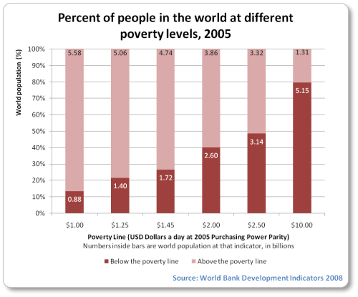
21 thousand people die dayly of hanger (http://www.poverty.com)

Slide 20
Improving is enough?
2002, in the last 30 years, in 49 poorest countries, doble the number of people living with under 1 dólar per day. UN estimates grow till 420 millionsby 2015 (http://www.bbc.com/portuguese/noticias/2002/020618_unctadae.shtml)
2015, UN say that 800 million people all over the world living under 1,25 dólar per day represents half of the number by 1990.

Slide 21
Who are the prisoners?
“From 2000 to 2015, the total prison population of Oceania increased by 59%, while that of the Americas increased by 41%; that of Asia by 29%; and that of Africa by 15%. Europe, in contrast, saw a 21% fall in total prisoner numbers”.
Jessica Jacobson, Catherine Heard and Helen Fair (2017) PRISON: Evidence of its use and over-use from around the world, London, Institute for Criminal Policy Research and Fair Trail :vii

Slide 22
Moral relations state-society
Enforcement Law | Soft | Tough
Tolerante | Open societies | Discriminatory societies
Hard | Moralic societies | Autoritarian societies

Slide 23
Social relations between power and care
Moralistic
(submission)
Open (marginal)
Autoritarian
(repression)
Discriminatory
(revolution)
Europe
US/Australia
Conflict
Less open sacrifice
Violence
More open sacrifice

Slide 24
Social organization principle
Elitism / desire
Misogyny / affection
Dissimulation / cognitive
Misogyny / domestic
Dissimulation / humiliation
Elitism / sacrificial

