Slide 1
Does so-called society exist? Globalization and the updating of the social sciences
António Pedro Dores, Abril 2018

Slide 2
Abstract
Descartes VS holistic thinking
Society as a product of state-market system; individuals similar to elites
Law & economy deny, everyday, justice and resources
Social sciences turn this main contradiction (political lies) in temporary/eternal dysfunctions (cognitive distractions)
Does human empathy and solidarity exist? Social sciences answer: No; normality shows society does not exist as agent – it is divided

Slide 3
Global village
Open up development to the Third World and poor people has been the motive of progress, since WWII
Stopped by 1973, the progress turn into globalizing technology (financial system; internet) to support new management at a distance

Slide 4
Global village (II)
Enthusiastic computer´s social movements (Apple, social media)
Global info-exclusion (English imperialism)
The work of the nations (new casts; Reich)
The law of the enemy (Sachs)
Freezing knowledge as useful knowledge
Stop social sciences paradigm work, specially in economics

Slide 5
Loïc Wacquant´s theory
Neo-liberalism
STATE
Left hand
“workfare”
Right hand
“prisonfare”
Prison
CITY
Hiper-ghetto
Anti ghetto
Punishing the poor
Deadly symbiosis
CLASS
(market)
RACE
(ethnicity)
Urban outcast
(BODY)
Body and soul
Marginality, ethnicity and penality in the neoliberal city, 2014

Slide 6
Double meaning of society
Desirable elites
Misoginous / afectiv
Dissimulation / cognitif
Misoginous / domestic
Dissimulation / humiliation
Sacrificial elites

Slide 7
How globalization interfer with social sciences?
Post-modernity, knowledge society, non-discriminative society, high-tech society, post-war society, free and open society, advanced capitalist
Post-90´s “natural” globalization prove every optimistic trend wrong (Bourdieu, Habermas, Touraine)

Slide 8
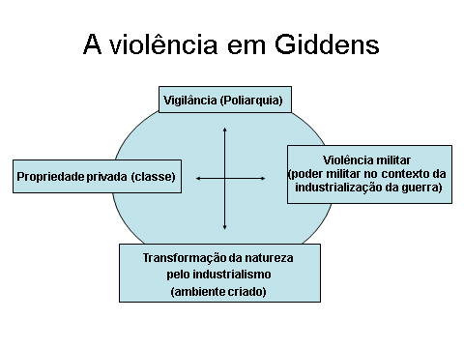
Giddens, A. (1992). As conseqüencias da modernidade. S. Paulo: UNESP.

Slide 9
Fire storm cases
“Why we do not cut all trees?” (Bush dixit)
Portuguese case: “We cannot trust the state to help to save lives” secretary of state
We are done (Paris summit)

Slide 10
What society is?
Something new and diverse, where we live in out of nature
Something natural, old, singular as a human experience as evolutionary result

Slide 11
Theoretical opportunities
“Spirit Level” Wilkinson & Pickett (2009)
“The Som Also Rises” Clark (2014)
Human society as a natural history (Morris´ Western Domination; Fara´s Science: a Four Thousand Years History; Graeber´s Debt – the First 5000 Years)

Slide 12
Fim
http://iscte.pt/~apad
http://iscte.pt/~apad/estesp
http://iscte.pt/~apad/estesp/trilogia.htm

Slide 13
Futuros Imaginativos uni-vos
DEMOCRACIA ABOLICIONISTA
Soberania
Legitimidade
PERMACULTURA
DIREITOS HUMANOS
Interesses diversos,
livres
Juízos morais
Iguais para todos
Níveis de
Realidade
Social
Construídos
CIENCIA CENTRIFUGA
ANTI-EXTRATIVISMO
Corrupção
Dinamismo
Impunidade
Privilégios
JUSTIÇA TRANSFORMATIVA
Depressão
Esperança
RENDIMENTO BÁSICO INCONDICIONAL

