Slide 1
Social differentiation and conspiracies
António Pedro Dores
Braga, 1rst to 3rd September 2016
Economic Crisis and Crime

Slide 2
Radical and subtle
Nationalism – Global inside Europe?
Targeting the weak – including the isolated members of dominant classes - is not what we are denouncing as wrong doing?
Searching for causes at structure or individual levels is missleading

Slide 3
My presentations
Political economy alone is misleading to address criminalization processing – market system instead people
Conspiracies is taboo subject because it refers to imbedded discrimination in social theory – avoiding ideology debates

Slide 4
“Global capitalist legal system, in the bottom of itself, is legalized corruption. Where crime begun (are finance operations legal or not) is not a legal problem. It is a plain political quarrel – it is a dispute of power.”
Slavoj Žižek
Considering Brazilian coup d´etat taking place at the time of Rio Olimpics Games´16

Slide 5
Table of content
Recent conspirative classes
State structures over time
Social theory limits
Building update theories

Slide 6
Why democracy colapse happens?
Differentiation of people:
Those who imagine society as collection of free individuals (politics as liberty)
2) Conspirative classes: those who are
blocking new ways of sustainable life
(politics as lobbying)

Slide 7
Traditional conspirative classes
Kings
Aristocrats
Clergies
Bureaucrats
All those groups that develop and retain social secrets, through special languages

Slide 8
Modern conspirative classes
Barons and gangsters as conspirative melting capitalist classes 1820/1930
Bankers and politicians as conspirative melting management classes 1945/2000
Conformist and “good” people classes
Repressed and “bad” people classes

Slide 9
State Structures
States that support markets building
States that manage the markets
Social state, social partner
Global state, coalition to build global markets
From local proletariat to global proletariat

Slide 10
Corruption as conspiracy
2008´s financial crisis shows failure of 20 years old global banking institutions
States shows to be out of representation
Net people organizations are specialized
Judicial system trapped by conspirative criminalization (drugs and migrants)
Call to fight corruption (Sócrates; Lula)

Slide 11
Social theory limits
Modernity (the last 60, 200 or 500 years) or homo sapiens 5,000 or 50,000 years’ experience
Lower classes experiences as ascending social classes, no war considered
Hierarchy as spontaneous event
Eternal Montesquieu State structure

Slide 12
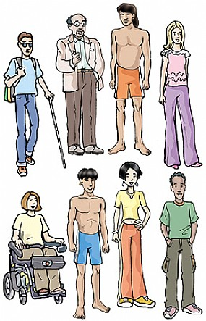
People out of society, society out of transformation

Slide 13
Judiciary out of globalization
Global powers are enemy and not allies of the judiciary
Garzón case and the end of globalization of judiciary
Judiciary becomes politics (Italy, Brazil)
Human rights without supporters, nor US or EU

Slide 14
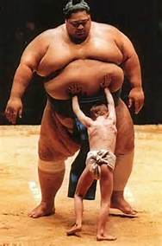
Social struggles at a turn
New configurations
call for new theories

Slide 15
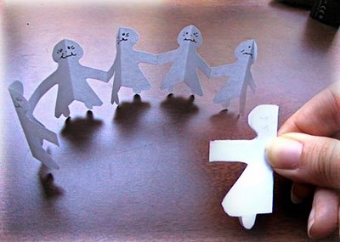
Structural funcionalism, media and elitist meritocratic explanation
Polítics | Culture
Economy | (modern) Society

Slide 16
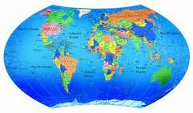
Critique, internacional relations and modernist explanations
Capitalism | Industrialism
War | Social control (security)

Slide 17
Imaginative futures unite
ABOLICIONIST DEMOCRACY
Soberania
Legitimidade
Interesses diversos,
livres
Juízos morais
Iguais para todos
Níveis de
Realidade
Social
Construídos
CENTRIFUGAL SCIENCE
ANTI-EXTRATIVISM
Corrupção
Dinamismo
Impunidade
Privilégios
TRANSFORMATIVE JUSTICE
Depressão
Esperança
CITIZEN INCOME

Slide 18
Big questions
How it happens that 1% people shows themselves with +99% strength?
Is it possible to overcome social inequality? What is equality?
Should people expect justice to be delivered by judicial systems? Or peace by security systems?
How all social elites – and social theory – come together?

Slide 19
The end
http://iscte.pt/~apad
http://iscte.pt/~apad/estesp/trilogia.htm

Slide 20
Evolution of human social nature
Doing
Voice
Being

