Slide 1
Alternatives to retaliation
António Pedro Dores
November 2018

Slide 2
The problem
Alternatives to imprisonment become a prison reform issue
No effective solutions for crime prevention

Slide 3
My problem
TINA and no society: indispensable imprisonment and no empathy
Return of fascism to my life
Poor ghettoised theory on prisons

Slide 4
My solution
Opposition to imprisonment and fascism (Human Rights)
Opposition to specialized social theory
Building holistic social analyses

Slide 5
Index
Precarity of social theories
Life is natural
Why society would be out of life? And prisons out of society?
Start anew, again, facing the catastrophe

Slide 6
Precarity of social theories
VALUES | PACIFIST STATES OF MIND | MARGINAL STATES OF MIND
Liberty | Confidence (cooperation) | Boycott
Equality | Legitimacy (representation) | Subversion
Fraternity | Solidarity (order) | Retaliation

Slide 7
European traffic

Slide 8
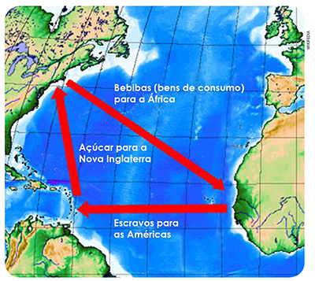
North-american traffic

Slide 9
Penitence democracy

Slide 10
Precarity of social theories
We are (not) free and equal, whenever is the state that warrantee us that status – M.Kuhn
“We, humans, are not self sufficient”; one needs each other and nature to survive and reproduce – as indigenous people well know as basic knowledge.

Slide 11
Power social theory
STATE
CITY
workfare
prisonfare
CLASS
RACE
BODY

Slide 12
Care and identity discriminative social organization
Conatos
POWER
Identity
Expectations
VIOLENCE
Tanatos
Notes:
The dark part of society is not represented
There is two dark sides: a) the lives of the “losers” (toped by prisoners) – represented by the triangle which vertices is down; b) the top conspirations of those who lead economy and states

Slide 13
Exploring retaliation
Penitentiary symbolic and practical activities
Criminal juridical justifications and punitive discrimination
Punitive political and professional turn
State and personal secrets safeguarding status quo (corruption, Wikileaks, global surveillance apparatus, CIA prisons)

Slide 14
Political and penal power out of society
Communication
POWER
support
Identity
Expectations
VIOLENCE
tabu
Retaliation
Notes:
Penitentiary have a ideological result: people see society shorter than it really is. Dark sides are hidden from popular conscious.

Slide 15
Retaliation produce safety feelings
After II WW, Human Rights declaration was possible do the post-catastrophe ambience
From 1973 oil crises on, economic confidence solidarity has been substituted by neoliberal precarity and suspicion
Political (ir)responsibility produced fake news (to go to war) and causes retaliation popular claims (criminals and politicians)

Slide 16
Integration or participation?
Public apathy regarding prison human rights is parallel to political apathy
Failure of public integration policies both at poverty and political levels
Growing of retaliation needs
Alternatives to imprisonment reinforce penal system (as well critical theory reinforces social theory)
Notes:
Penitentiary are part of the apparatus used by the states to deal with popular rage against what is wrong in their lives
Normally penitentiary system is directed to bottom side of dark part of society; now and then also directed to the top dark side.

Slide 17
Alternatives to retaliation: what about war and crime?
Communication
POWER
support
Identity
Expectations
VIOLENCE
tabu
Retaliation

Slide 18
Final remarks
The state deliver easy and legitim retaliation, such stigma, policing and imprisonment, in exchange of elite irresponsibility (at war).
Are we able to replicate the spirit of post-catastrophe before it really happens and turn solidary instead of punitive retaliators?

Slide 19
The end
http://iscte.pt/~apad

